Slide 1

Smart class room monitoring system
II B.TECH(AI&DS) 24-25 SEM2
REAL TIME RESEARCH PROJECT BATCH NO: 23
TEAM MEMBERS
Under The Guidance
Mr. SINDUJA
Department of AI&DS
1 | 24895A7201 | E.PREETHAM
2 | 23891A7230 | SAINISH SINGH
3 | 23891A7245 | M.SHIVA SHANKAR

Slide 2
Contents
Abstract
Introduction
Existing system and it’s cons
Proposed system and it’s pros
Tools used
Conclusion

Slide 3
ABSTRACT
This project develops a smart classroom monitoring system to detect students sleeping during class using computer vision techniques. The system employs a camera to capture real-time video, leveraging OpenCV and optionally Dlib for facial landmark detection to identify sleep through eye closure or posture analysis. It logs instances of detected sleep, captures images, and generates hourly reports in CSV format, including timestamps and corresponding images. Designed for deployment on a PC, the system enhances classroom management by providing teachers with actionable insights into student engagement, with potential extensions for face recognition and automated notifications.

Slide 4
Introduction
In modern educational environments, maintaining student engagement during classes is a critical challenge for educators. Distractions, fatigue, and lack of attentiveness, such as students sleeping, can hinder the learning process and affect overall classroom dynamics. Traditional methods of monitoring student behavior rely heavily on manual observation, which can be inefficient and subjective, especially in larger classrooms. To address this issue, this project introduces a smart classroom monitoring system that leverages computer vision technology to automatically detect students who are sleeping during class. By utilizing a camera interfaced with a PC, the system processes real-time video feeds using OpenCV and optionally Dlib for advanced facial landmark detection, identifying sleep through eye closure or posture analysis.

Slide 5
Existing system :-
Sleep Detection in Online and Offline Classrooms Using Computer Vision
Description: Uses OpenCV and deep learning models (like CNNs or Haar cascades) to detect closed eyes and head posture to determine if a student is asleep.
Cons:
False Positives: Students looking down (e.g., reading or writing) may be misclassified as sleeping.
Privacy Concerns: Constant camera monitoring may raise ethical concerns.
Processing Power: Requires a high-performance system for real-time analysis, especially in large classrooms.
Lighting Issues: Poor lighting conditions can reduce accuracy.

Slide 6
Proposed system :-
Proposed System: AI-Powered Smart Classroom Monitoring System
This system integrates computer vision and deep learning to detect sleeping students, generate hourly reports, and capture images for review.
Pros of the Proposed System:
✅ Real-Time Monitoring – Detects sleeping students instantly and notifies instructors.
✅ Automated Hourly Reports – Generates logs with timestamps, reducing manual tracking.
✅ AI-Based Accuracy – Deep learning models improve detection accuracy over time compared to simple eye-tracking methods.
✅ Scalability – Can be expanded with additional features like emotion detection, engagement tracking, or even hand-raise recognition.

Slide 7
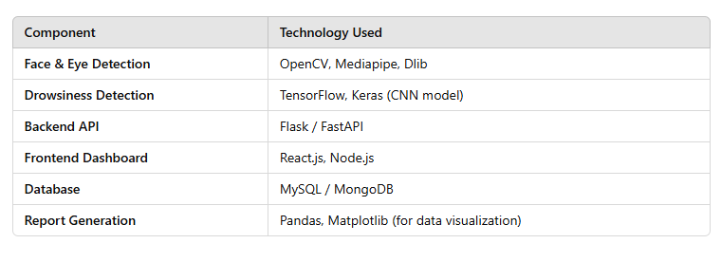
Tools used to implement

Slide 8
Final Workflow Summary
Camera Captures Video – Continuously records students. Frame Preprocessing – Converts frames to grayscale and resizes them. Face & Eye Detection – Uses OpenCV/Mediapipe to detect faces and eyes. Drowsiness Detection – AI model checks for closed eyes and head tilts. Sleep Alert & Image Capture – If sleep is detected, logs event and saves an image. Data Storage – Stores logs and images in a database. Live Dashboard Updates – Displays real-time alerts and hourly reports. Instructor Reviews Reports – Analyzes student engagement trends.

Slide 9
Conclusion
The Smart Classroom Monitoring System enhances student engagement by detecting sleeping students, generating reports, and providing real-time alerts using computer vision and deep learning. With an intuitive web dashboard for monitoring and analysis, it minimizes manual effort for instructors. The system is scalable and can be improved with features like emotion detection and LMS integration, making it a valuable tool for modern classrooms. 🚀

Slide 10
Thanks!

